Slide 1

Database management system ORPHANAGE MANAGEMENT SYSTEM
Under the Guidance of
P . SREE LAKSHMI Mam
Notes:
NOTE:
To change the image on this slide, select the picture and delete it. Then click the Pictures icon in the placeholder to insert your own image.

Slide 2

TEAM MEMBERS
S.No | Name | Roll Number
1. | Sravya | 2110030087
2. | Niharika | 2110030088
3. | Lahari | 2110030165
4. | Jayasree | 2110030178

Slide 3

What is the orphanage management system?
A system designed to keep records of Orphans in the Orphanage home.
The system comprises the create a new user and log in, Orphan’s basic details, medical information, and a search bar to easily find a particular Orphan.
Orphanage Information System is keen on the management of orphanage homes, they are the most valued or important records of orphans, and their transactions are needed to be kept for future reference.

Slide 4

PROBLEM STATEMENT
An orphanage is a place where children without parents care.
The orphanage management system manages the records, planning, and budgeting for the children in the orphanages.
Integrity, transparency, and accountability on these records become a major issue if the records are altered.
There are also circumstances where children are lost and then accommodated in the orphanages.

Slide 5

EXISTING METHOD
In the old process of adoption and donation donor have undergone many manual processes
Prospective adoptive parents need to register with an authorized agency
Home study and the child
Filling of the petition
Acceptance of the child
Pre-adoption foster care
Referral of the child
Court hearing
Court order
Follow up

Slide 6
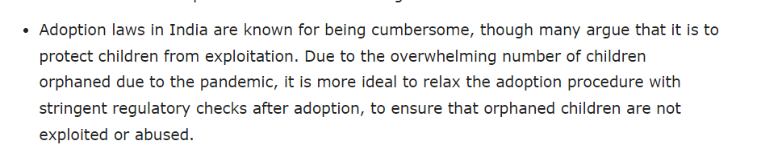
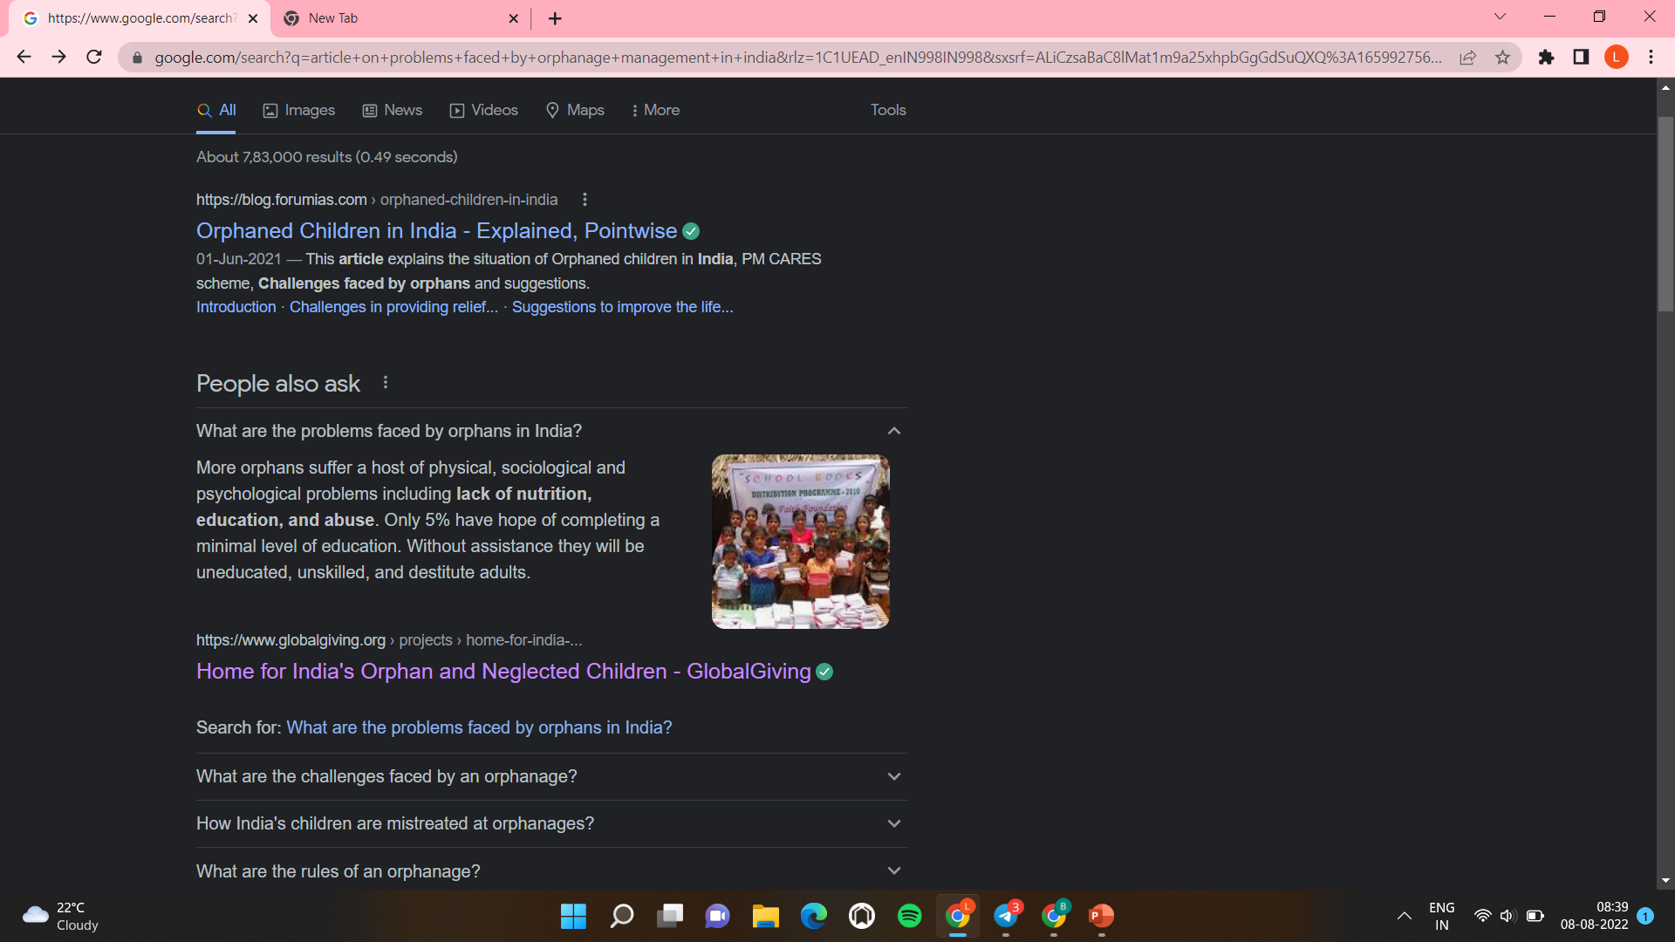
PROOFS SUPPORTING PROBLEMS IN EXISTING METHODS
https://blog.ipleaders.in/orphanage-laws-in-india-protection-of-orphan-children/
https://www.globalgiving.org/projects/home-for-india-s-orphan-and-neglected-children/

Slide 7
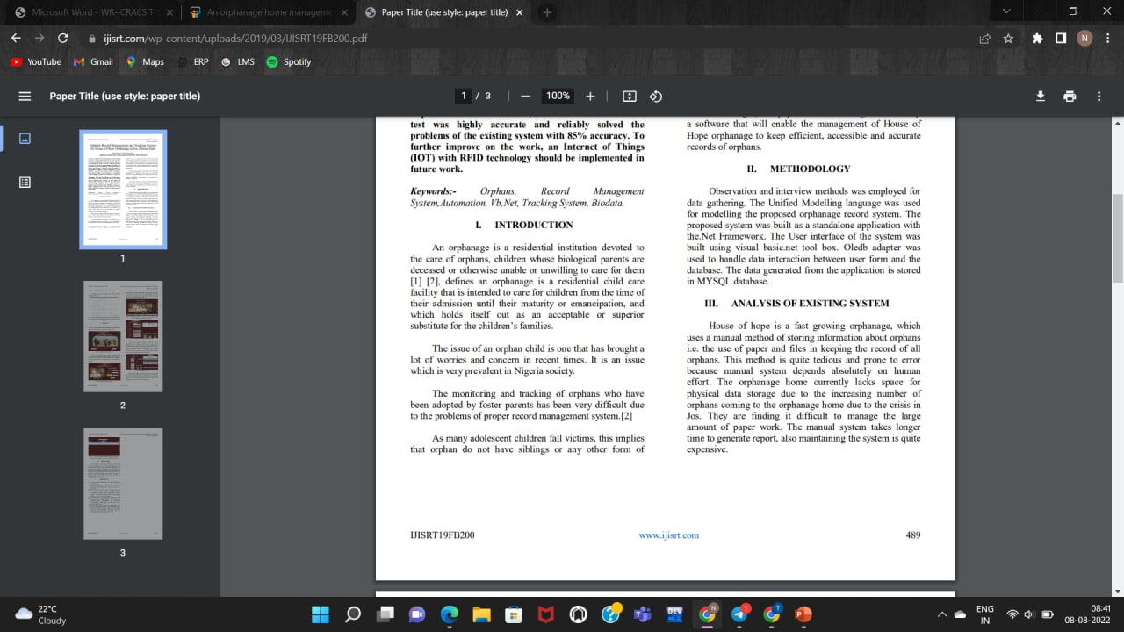
PROOFS SUPPORTING PROBLEMS IN EXISTING METHODS
https://ijisrt.com/wp-content/uploads/2019/03/IJISRT19FB200.pdf

Slide 8
PROPOSED SOLUTIONS
Our solution has this major points:
Faster data processing.
Secure System.
Data Integrity.
Back Up and recovery.
Tracking system
Data storage management.

Slide 9

PROPOSED ALGORITHM DESIGN TECHINQUE
As Orphanages are increasing day to basis simultaneously the helping hands are also increasing in the higher range.
The practical difficulty is finding out the real orphans and less knowledge about the donation details.
So the app was developed to help to reach needy orphans through volunteer donations.
It allows the users to search and find the orphanages on the internet and then they can donate to the orphanages whichever they want.
Motive of our paper is to eliminate the drawback of the previous application and to help orphans to the full extent.

Slide 10

DATA STRUCTURES NEEDED
The main pillar of reliability of the system is the backup of the database which is continuously maintained and updated to reflect the most recent changes.
MySQL is a relational database system.
The data will be stored in MySQL and it is possible to migrate data to other compatible databases.
MySQL is also a client-server system.
SQL is a standardized language for querying and updating data and for the administration of a database.
Here we are dealing with SQL code that is stored in the database system.

Slide 11

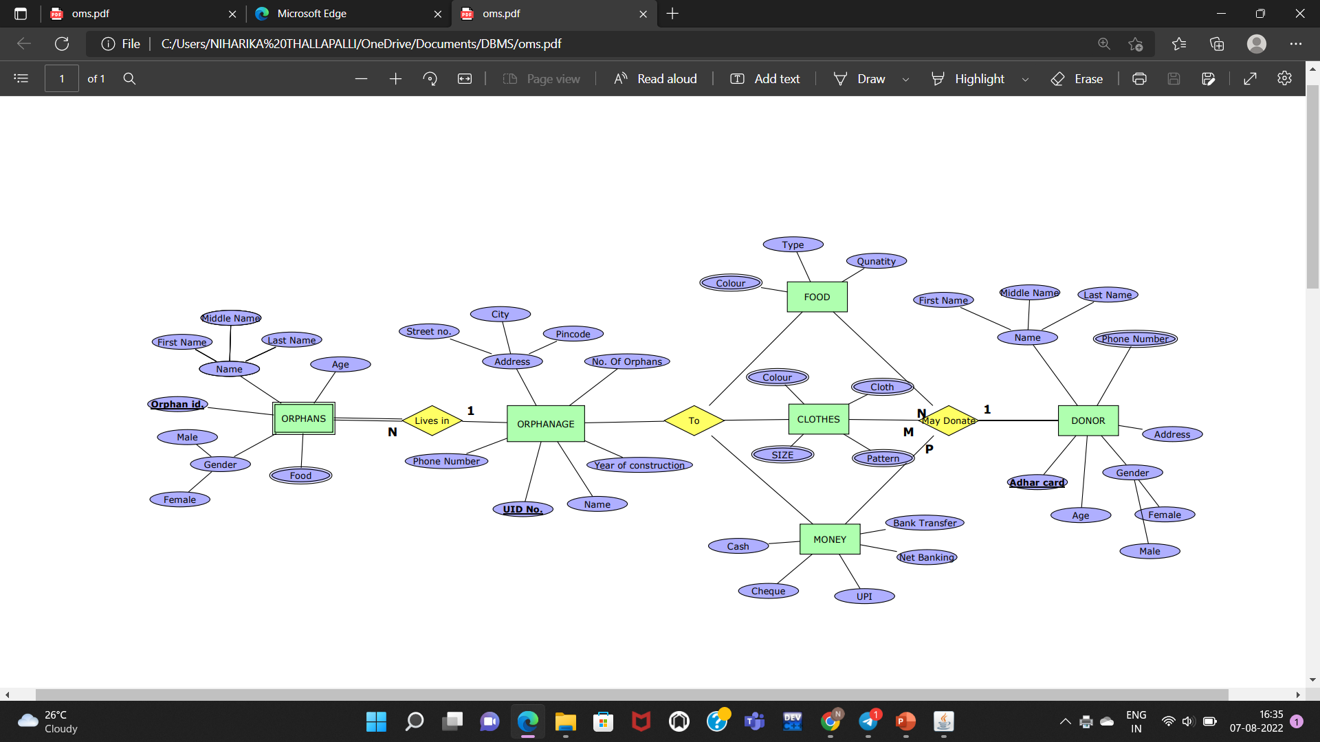
ER DIAGRAM

Slide 12

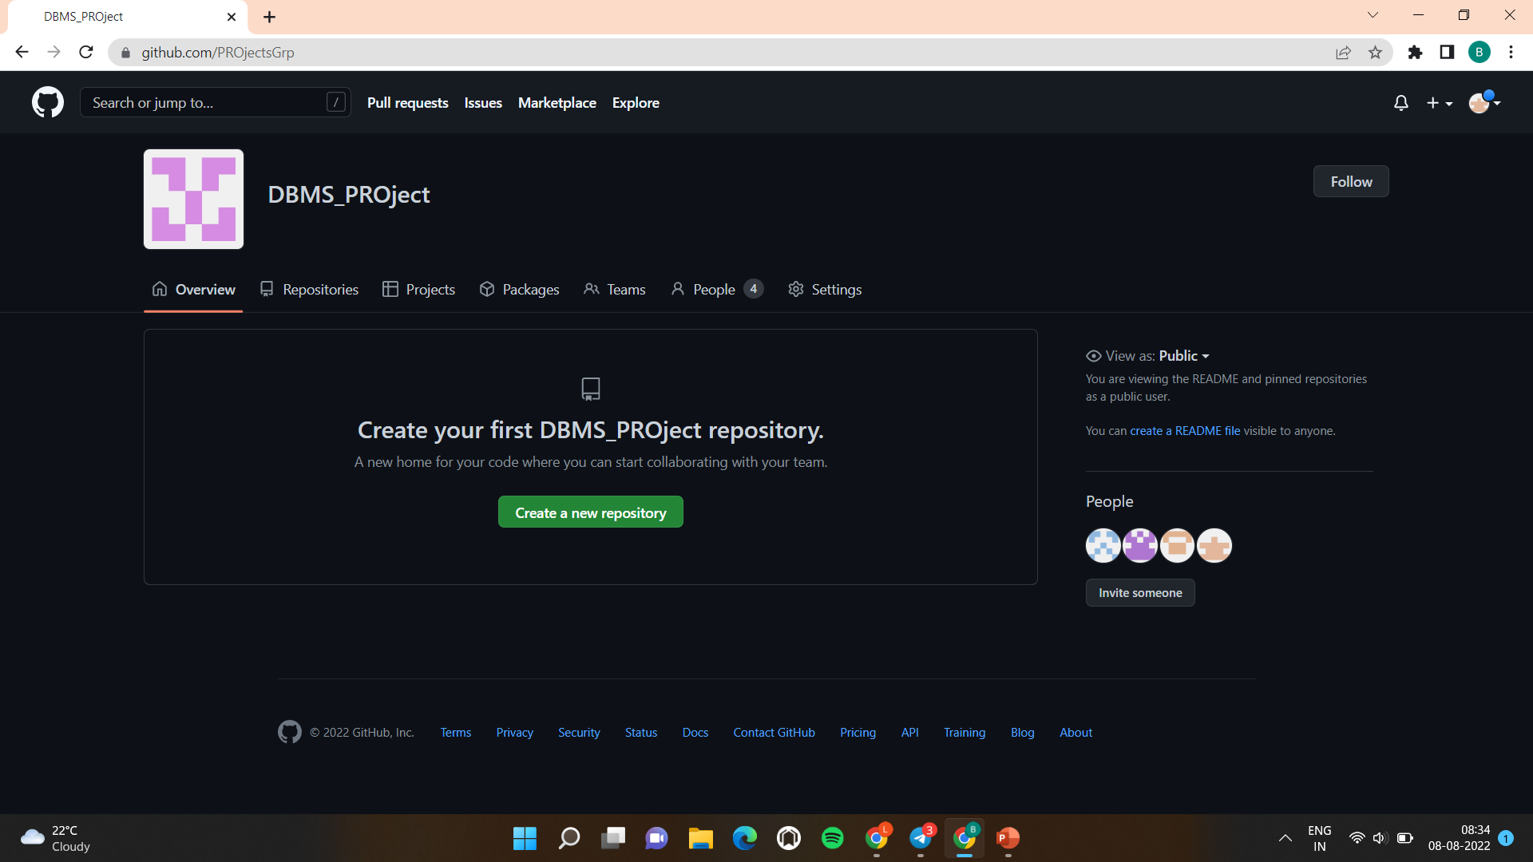
GITHUB SETUP
GITHUB LINK: https://github.com/PROjectsGrp

Slide 13
GITHUB SETUP
GITHUB LINK: https://github.com/PROjectsGrp
S.No. | Name | Github Link
1. | Sravya | https://github.com/2110030087
2. | Niharika | https://github.com/ThallapalliNiharika
3. | Lahari | https://github.com/Lahari1704
4. | Jayasree | https://github.com/jayasree1902

Slide 14

DIVISION OF WORK AMONG GROUP MEMBERS
S.no | Name | Roll Number | Work Allocation
1. | Sravya | 2110030087 | Editing & Research
2. | Niharika | 2110030088 | PPT & ER-Diagram
3. | Lahari | 2110030165 | GitHub setup & Research
4. | Jayasree | 211030178 | Research & ER-Diagram

Slide 15

REFERENCES
https://codeshoppy.com/shop/product/orphanage-management-system/
https://www.researchgate.net/publication/355107033_in_Digitalized_Orphanage_Home_Management_System_Consisting_of_Mass_Data_Entries_DIGITALIZED_ORPHANAGE_HOME_MANAGEMENT_SYSTEM_CONSISTING_OF_MASS_DATA_ENTRIES
https://www.academia.edu/41841004/ORPHANAGE_INFORMATION_MANAGEMENT_SYSTEM_OIMS_A_Project_Report
https://www.researchgate.net/publication/328225350_Design_and_Development_of_an_Orphans_Record_System
https://www.ijltemas.in/DigitalLibrary/Vol.3Issue7/137-141.pdf

Slide 16
THANK YOU

